Slide 1
Northpaw Project
Process
Elijah Molenkamp, Alyssa Sawyer,
Bob Zeng, Taylor Backer, and
María José Najas
Notes:
majo

Slide 2
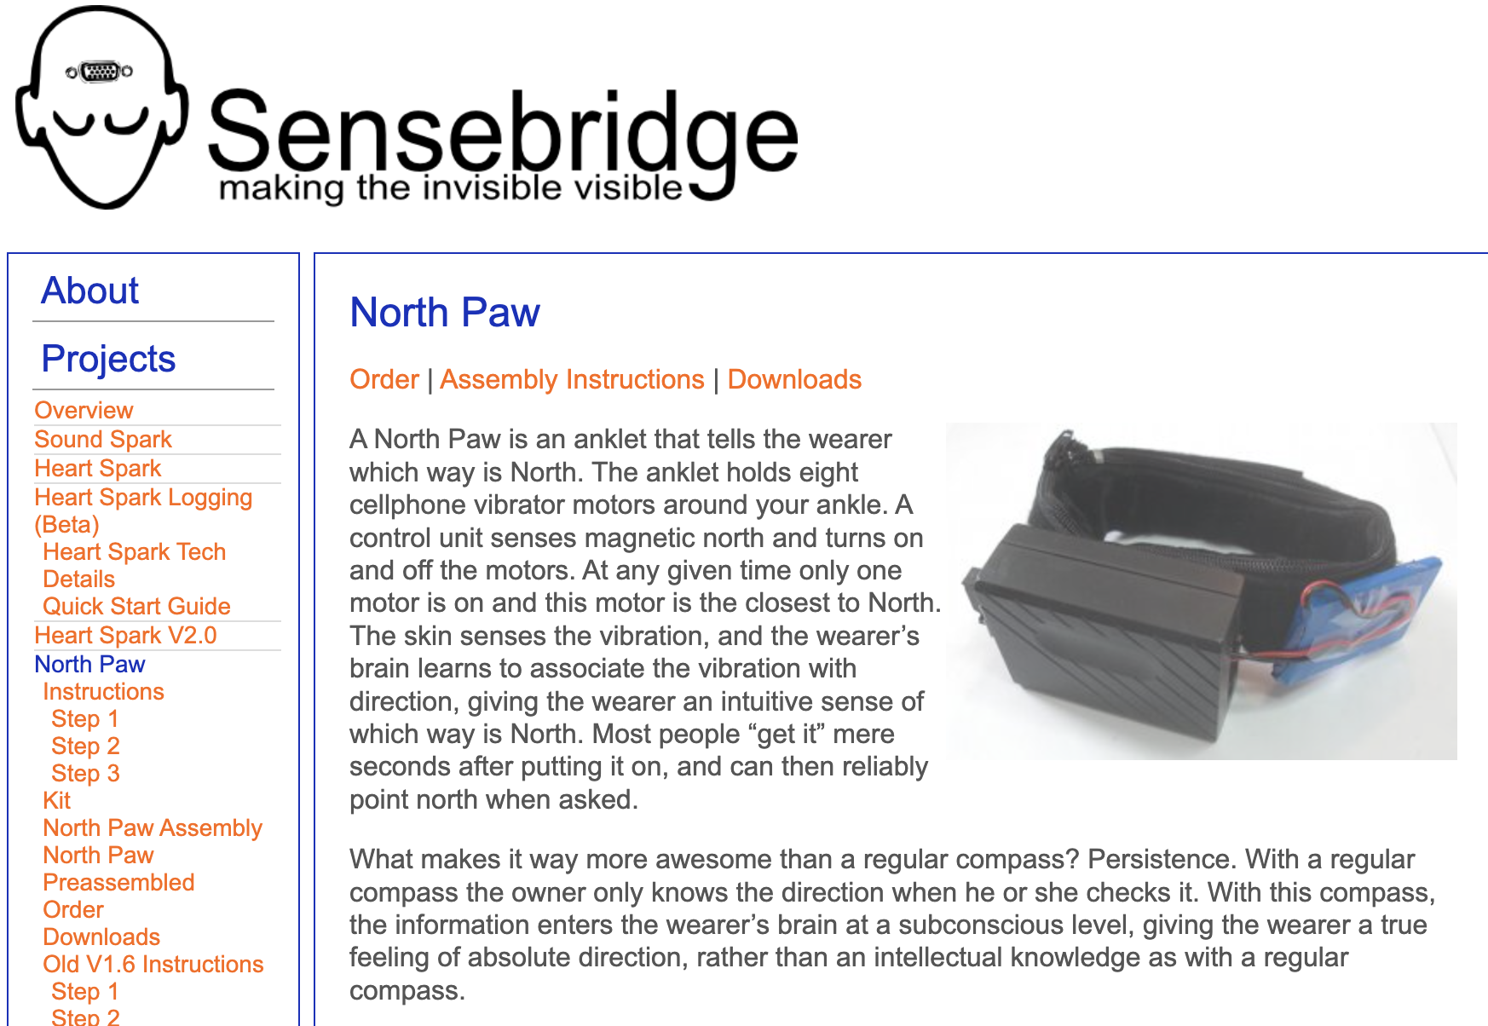
Northpaw by Sensebridge
Notes:
Taylor
So, Our project is based off of thethe NorthPaw by Sensebridge. The North Paw was an ankle that was able to tell which way was north by vibratoral motors. The idea was that the northpaw would help the wearer gain a better sense of magnetic direction if worn consistently, which equates to knowing wearing north is. We decided to divate from this device to create our own version, as explained by elijah

Slide 3
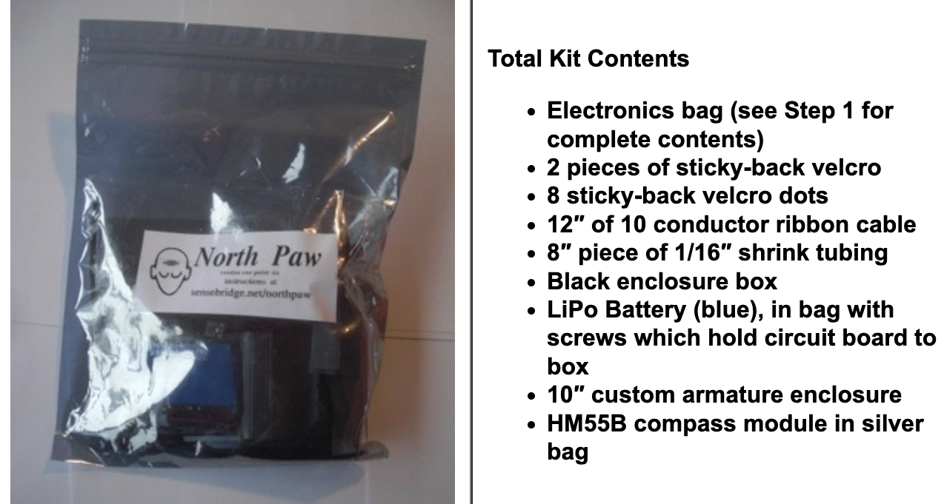
Choice to deviate from the original “Northpaw”
Resources
Many components were too old
Many factors…
Challenge
More creative freedom in using Arduino
Notes:
elijah

Slide 4
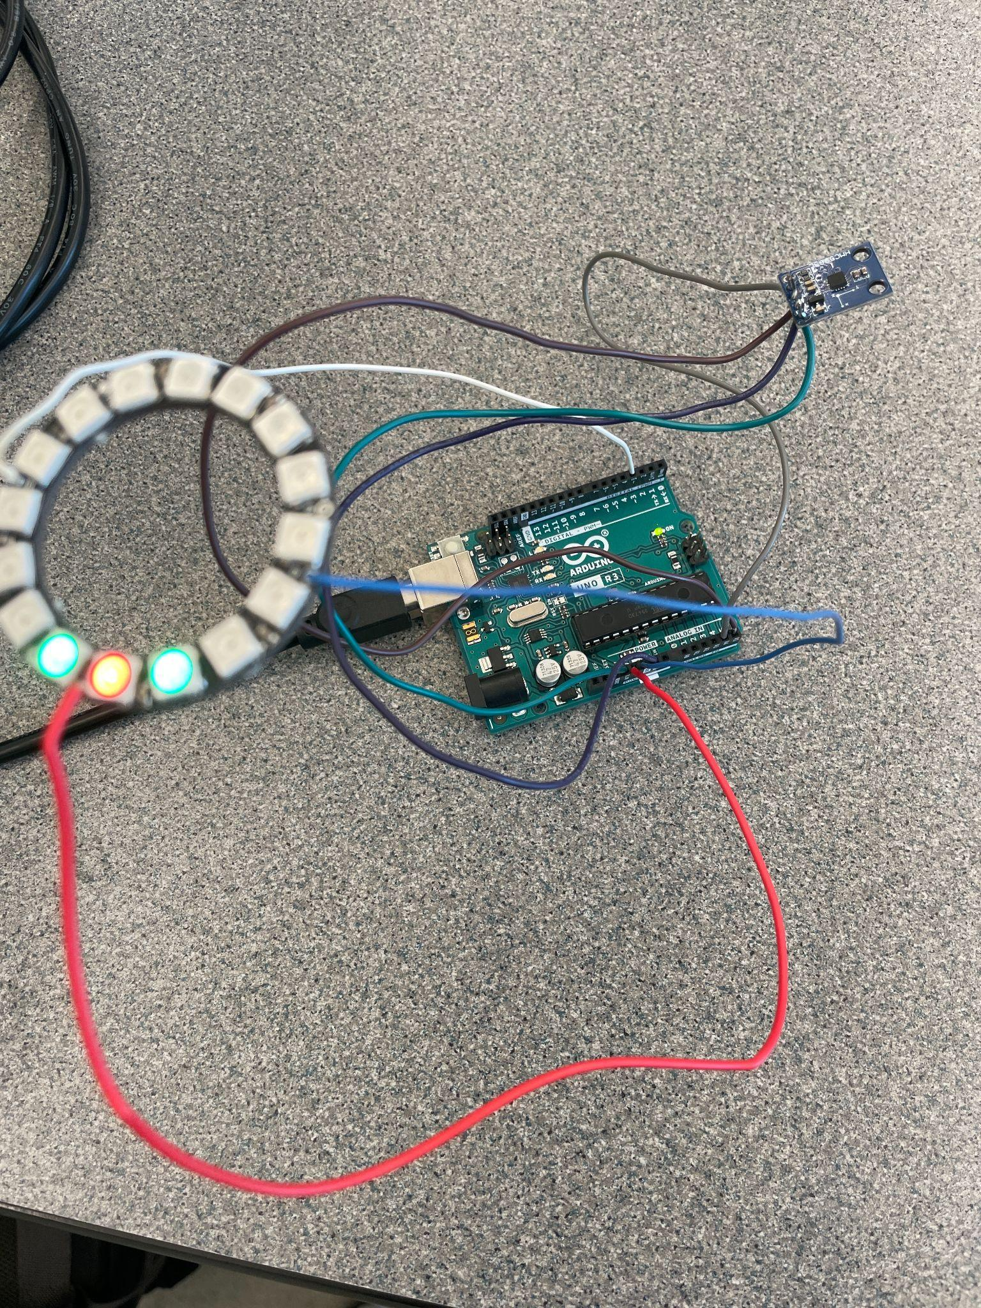
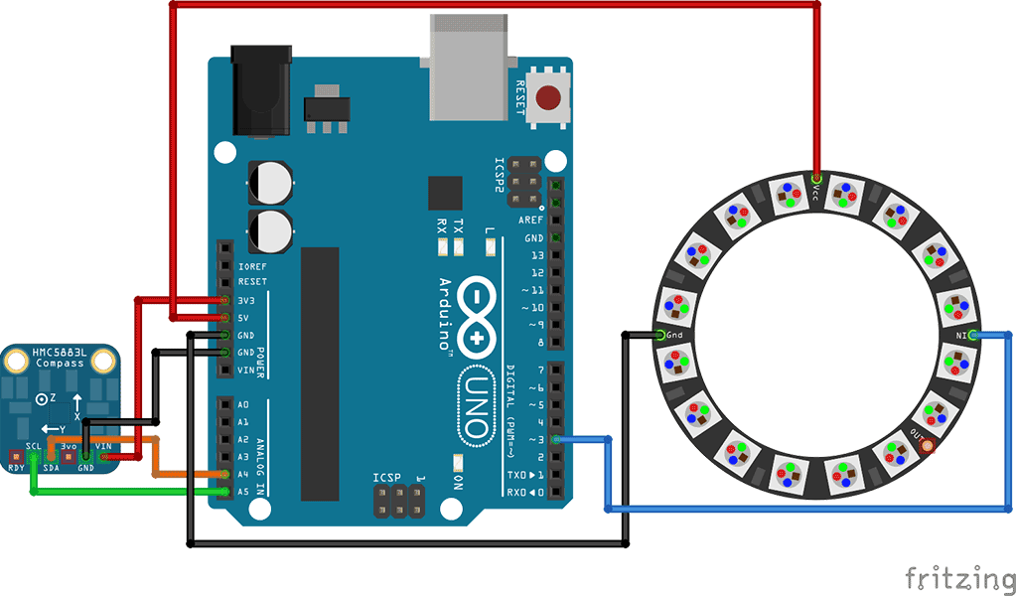
Initial Prototype: Getting compass module to work
Notes:
aly

Slide 5
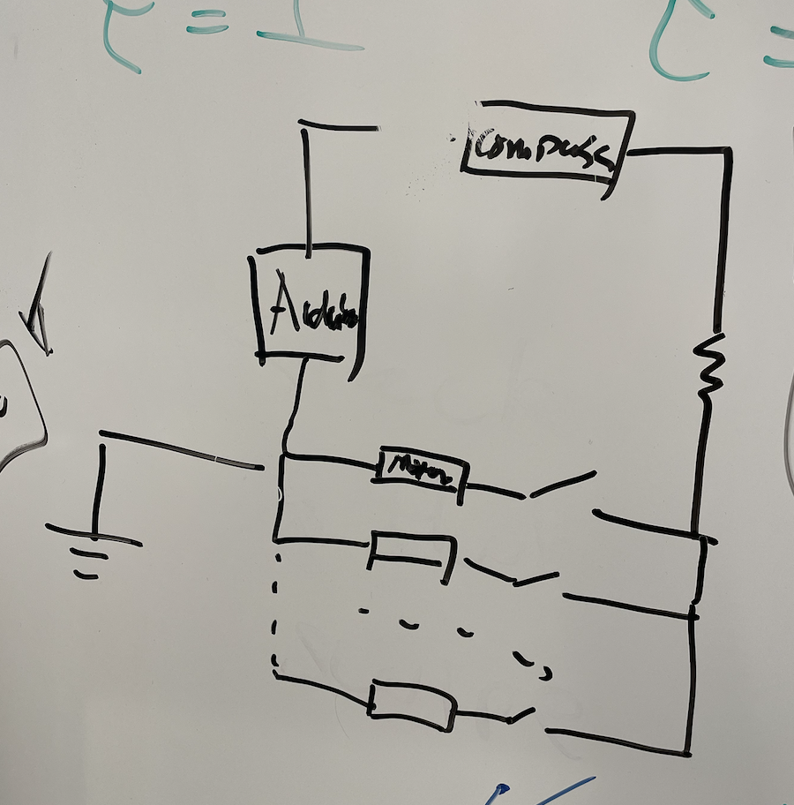
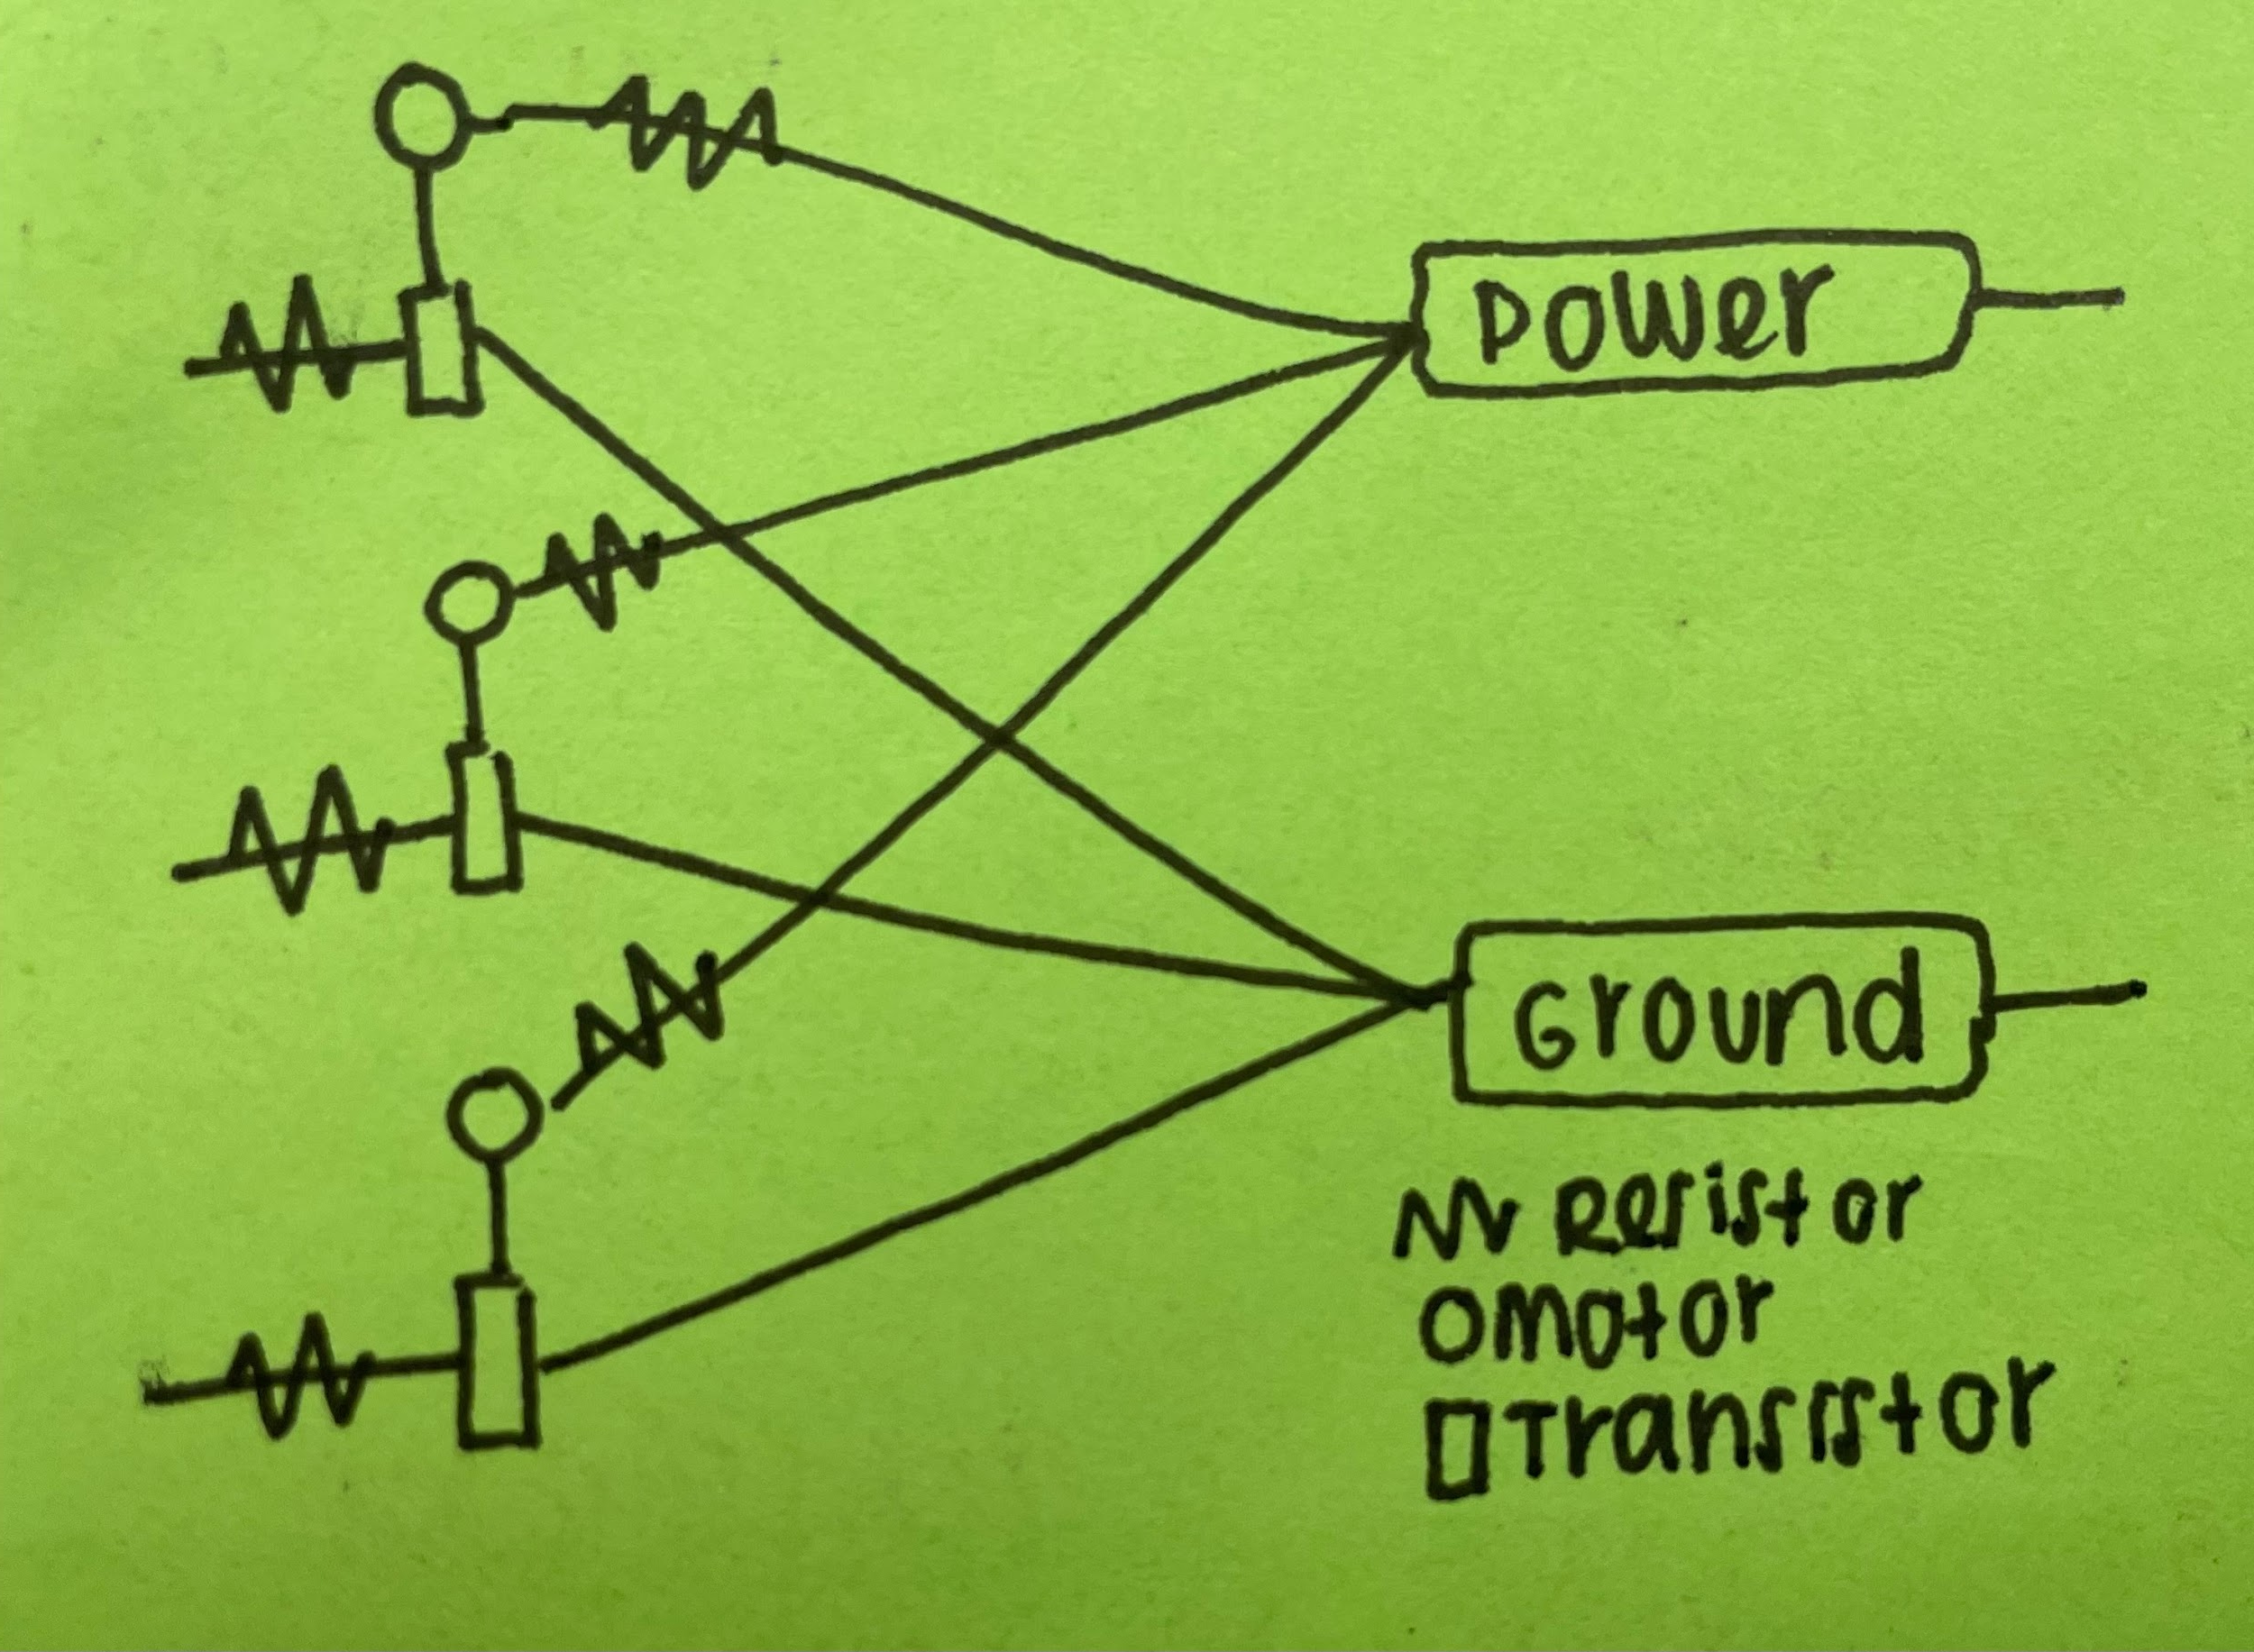
Overall strategy/schemat*
*not entirely accurate
Notes:
majo

Slide 6
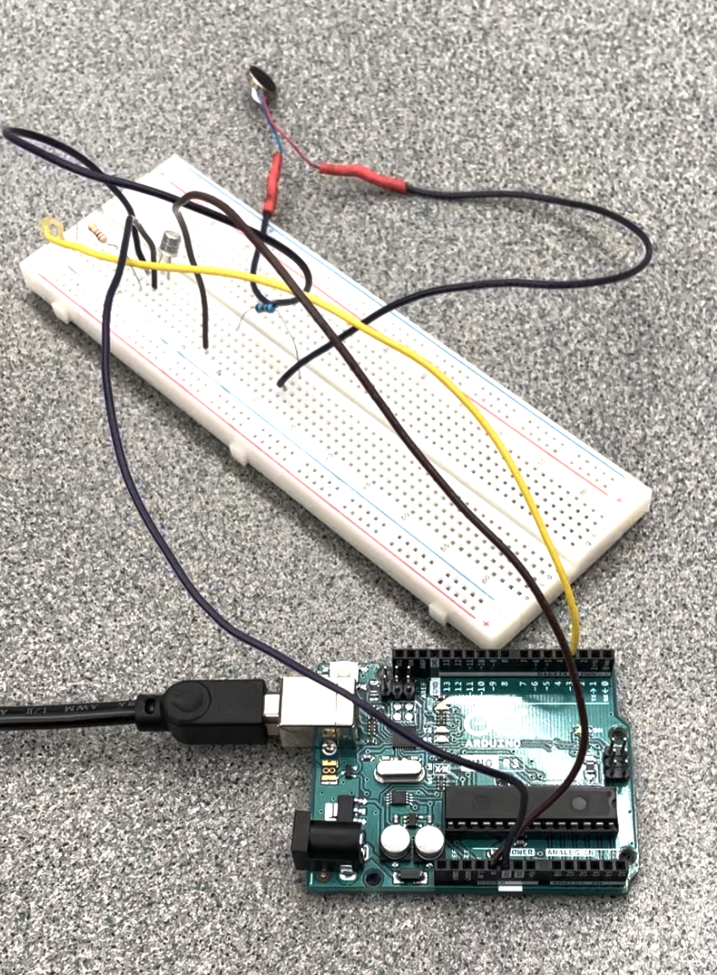
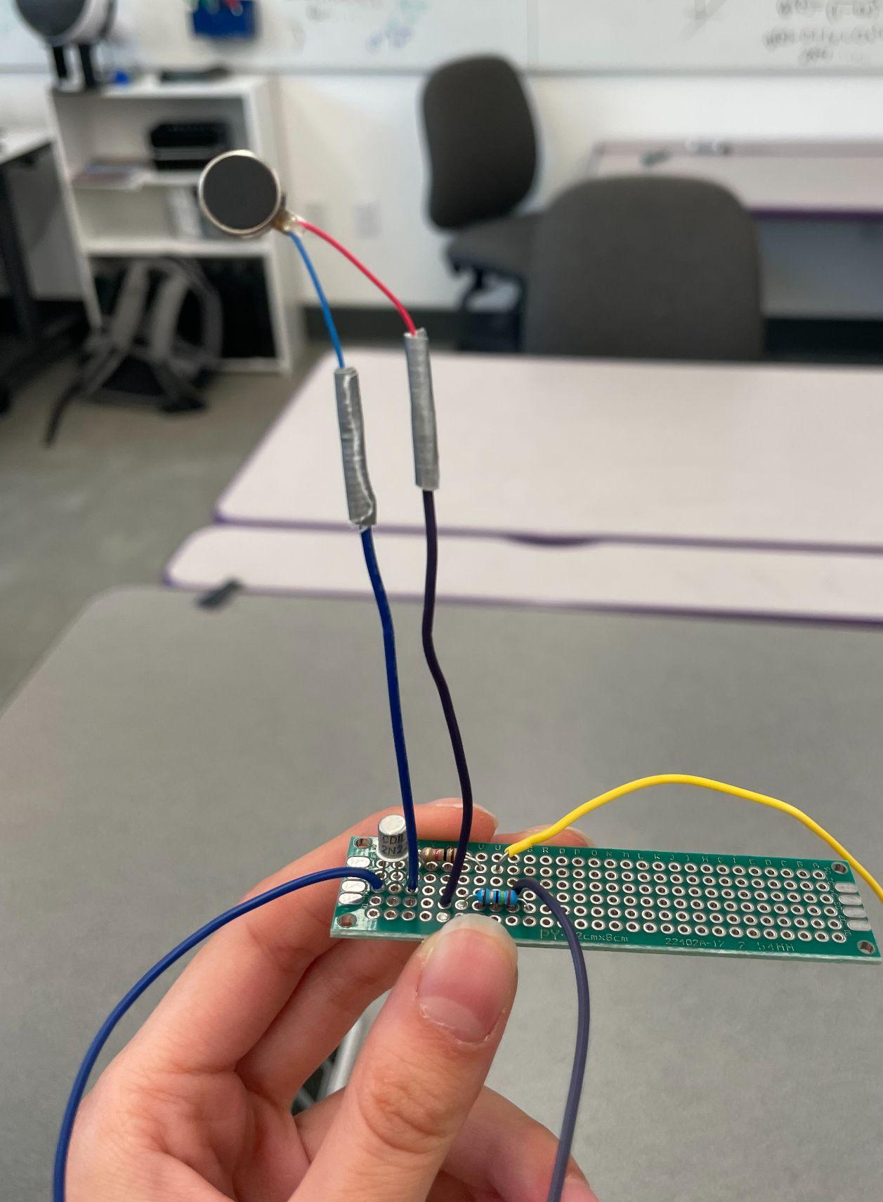
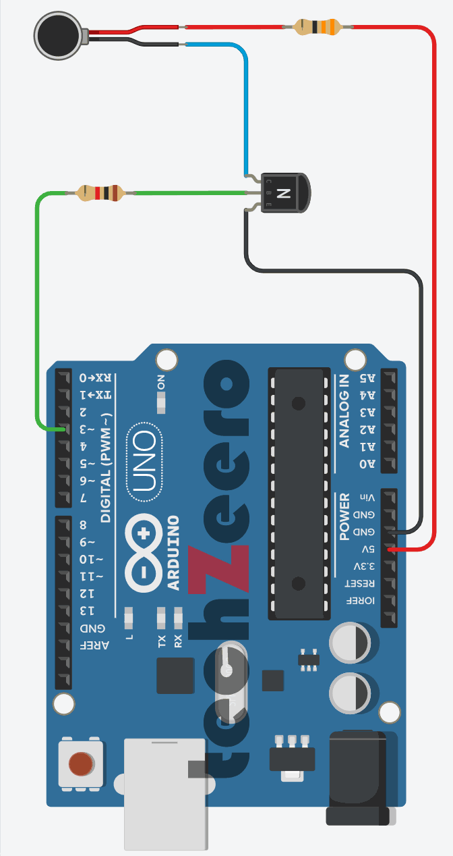
One motor
Notes:
aly

Slide 7
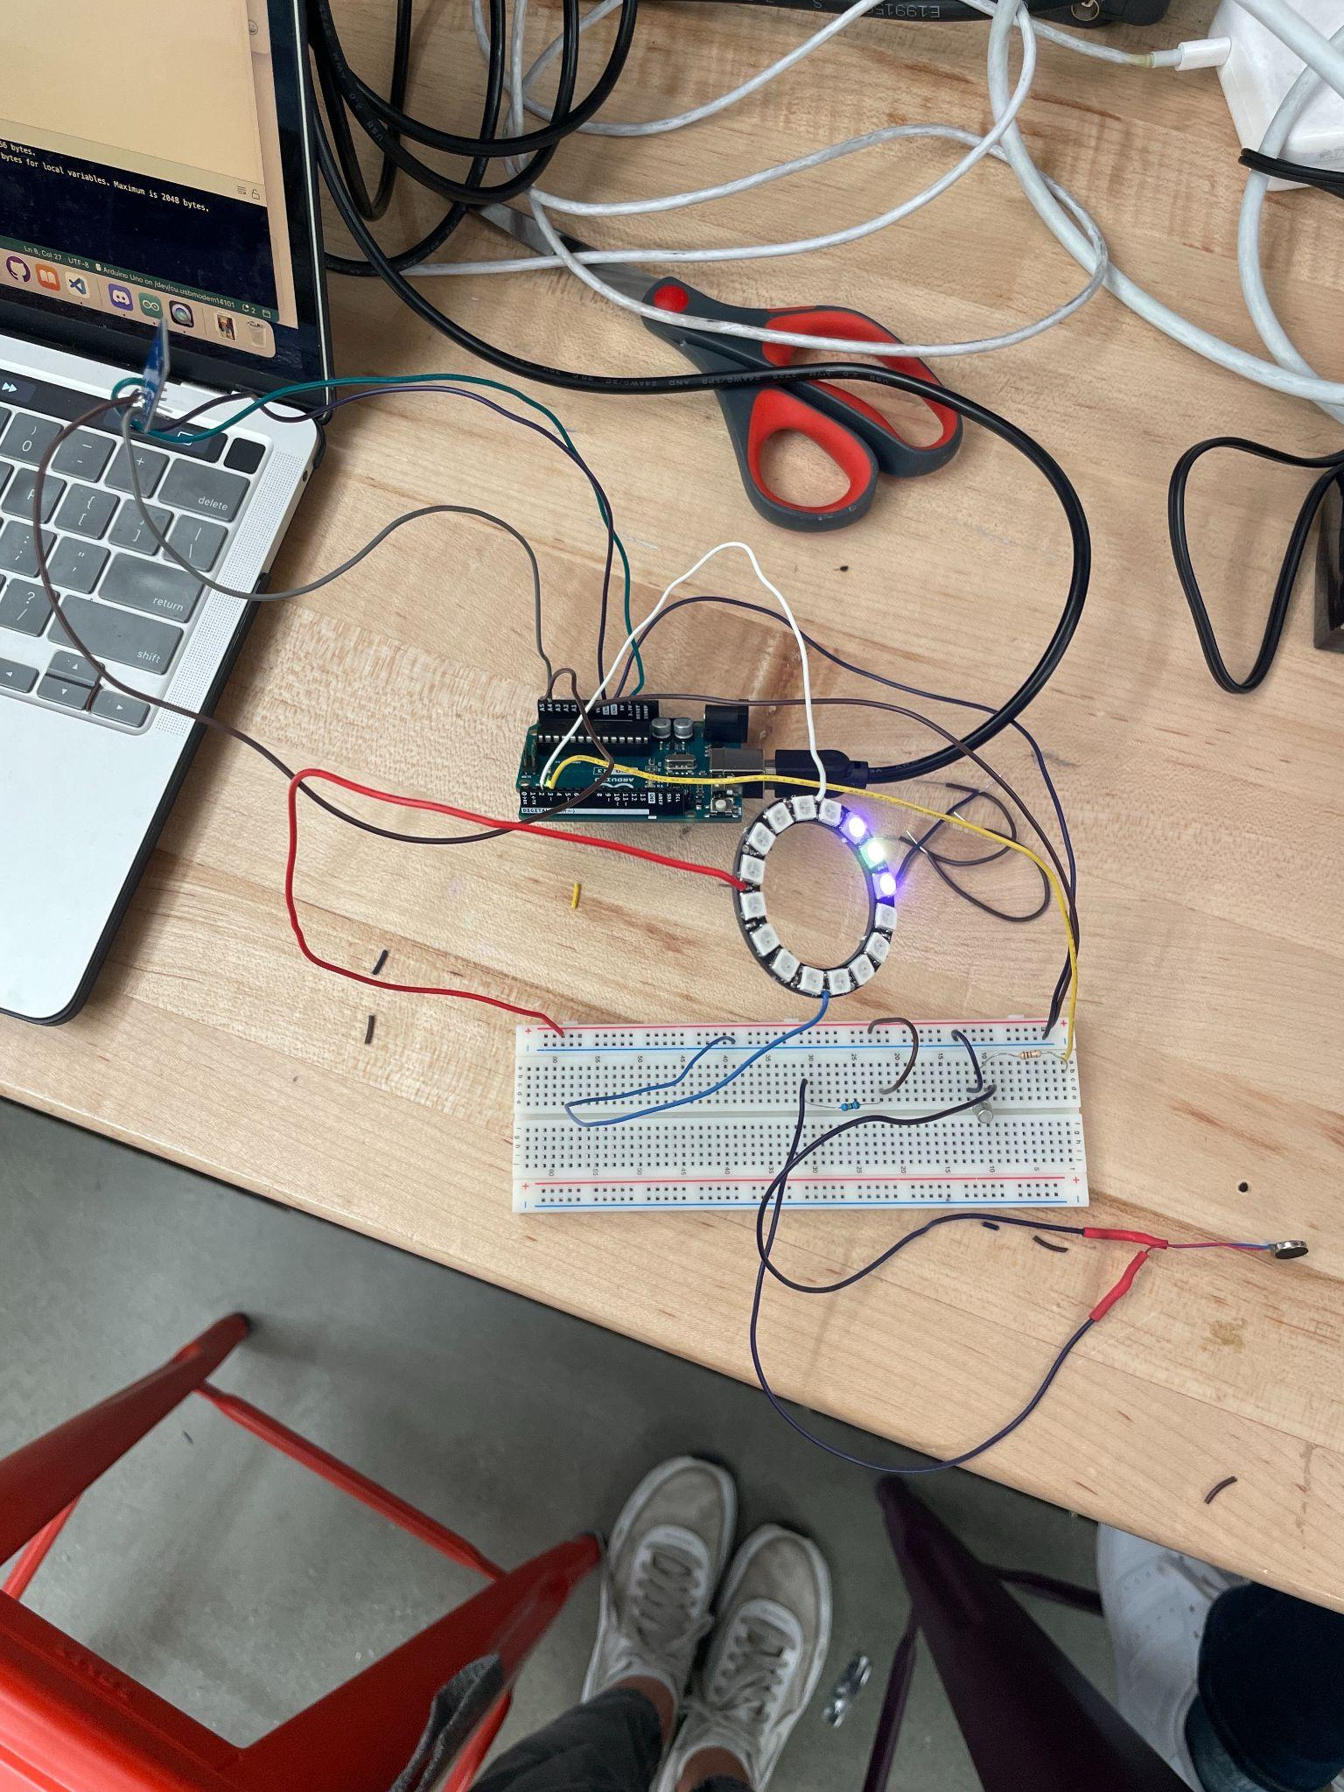
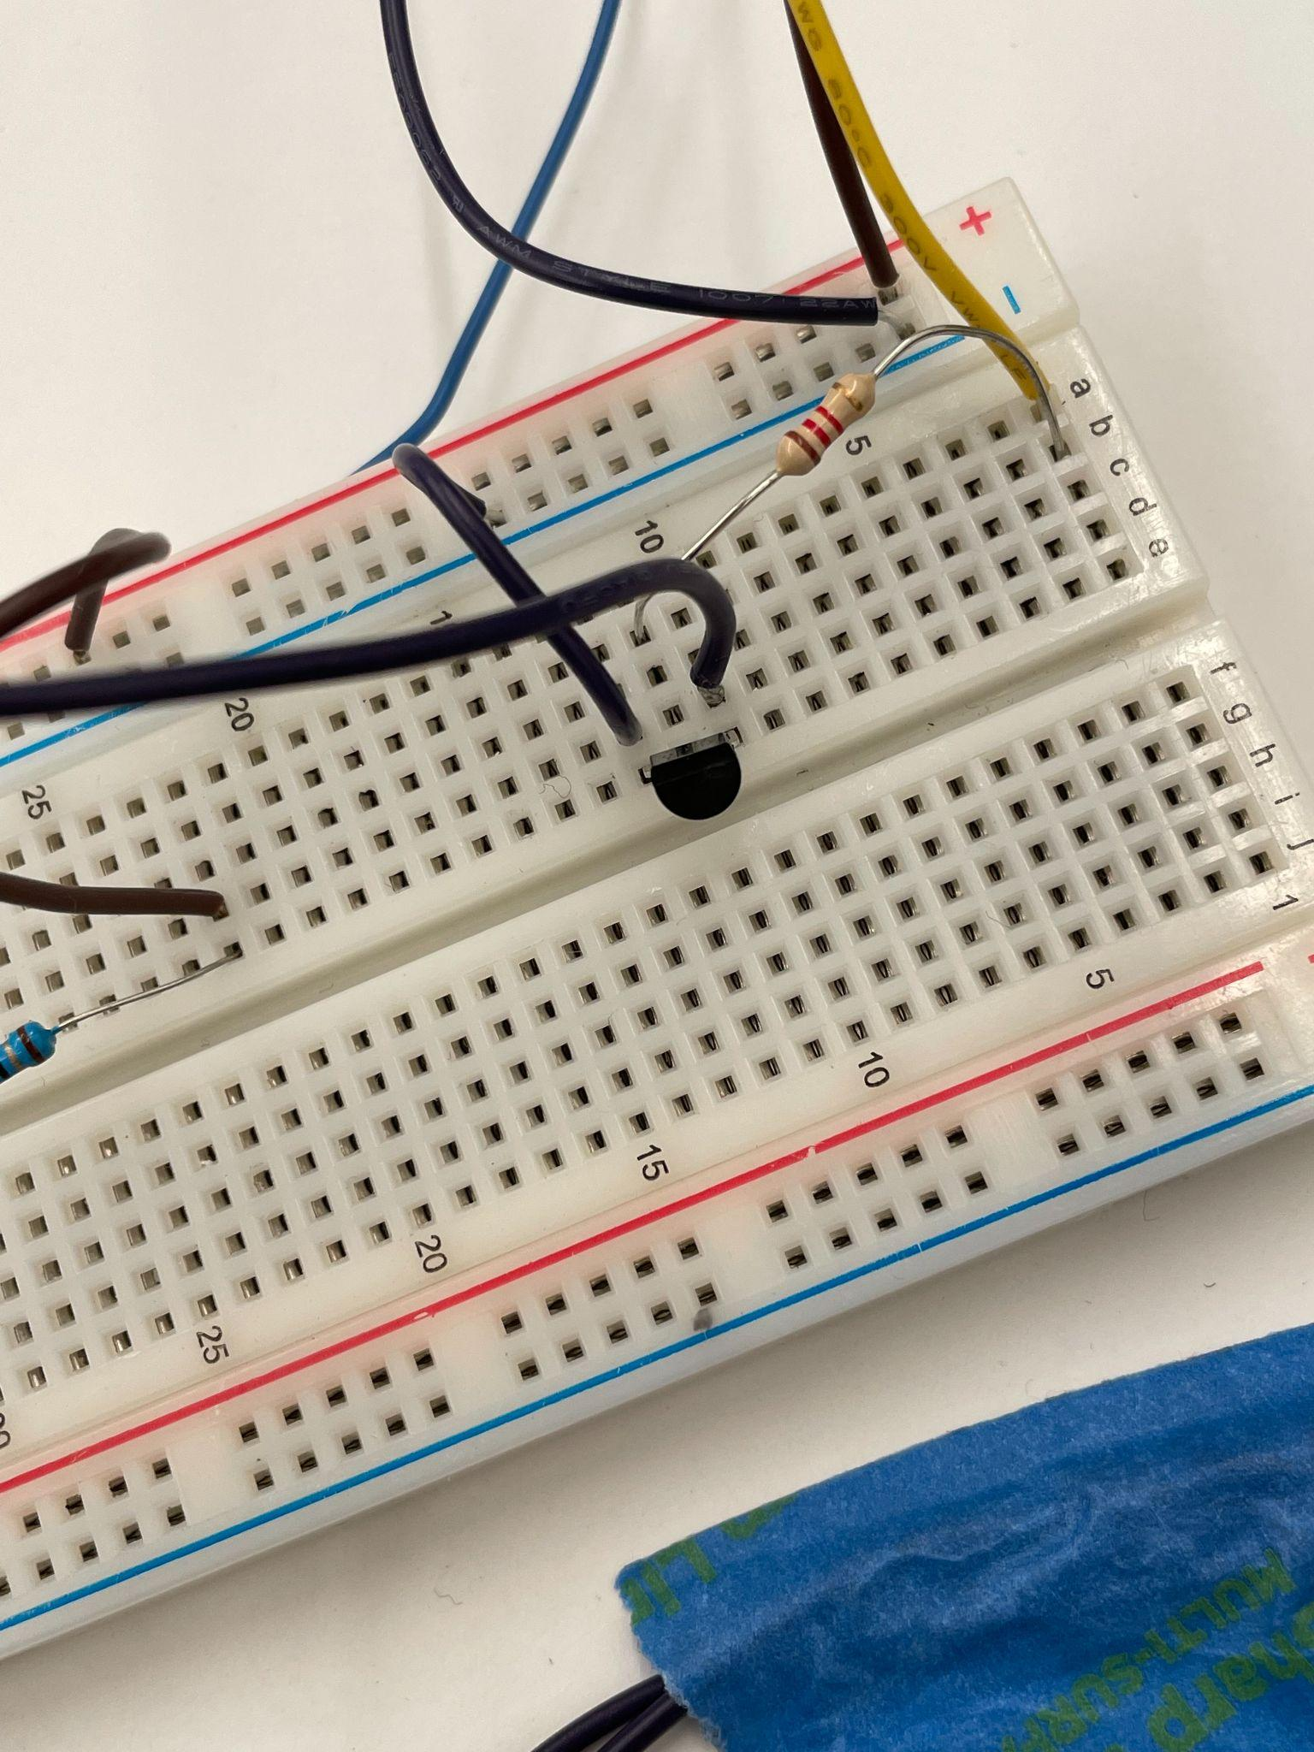
Motor and compass!
Notes:
taylor

Slide 8
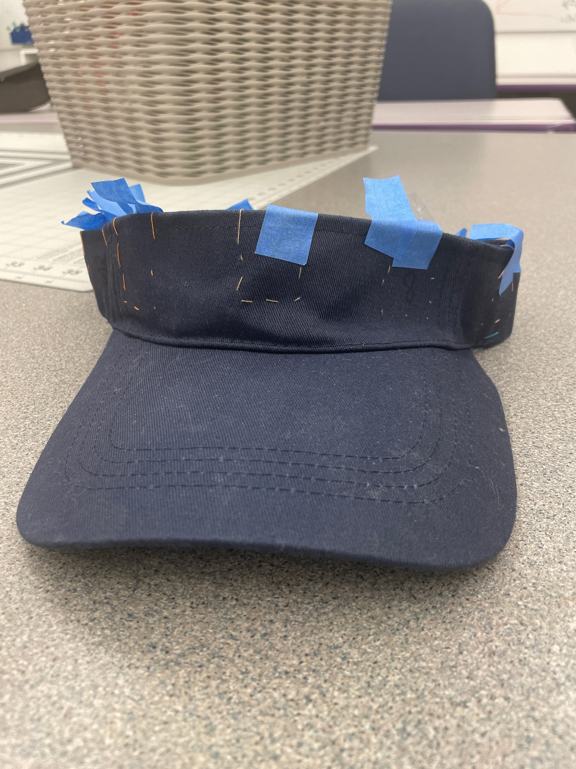
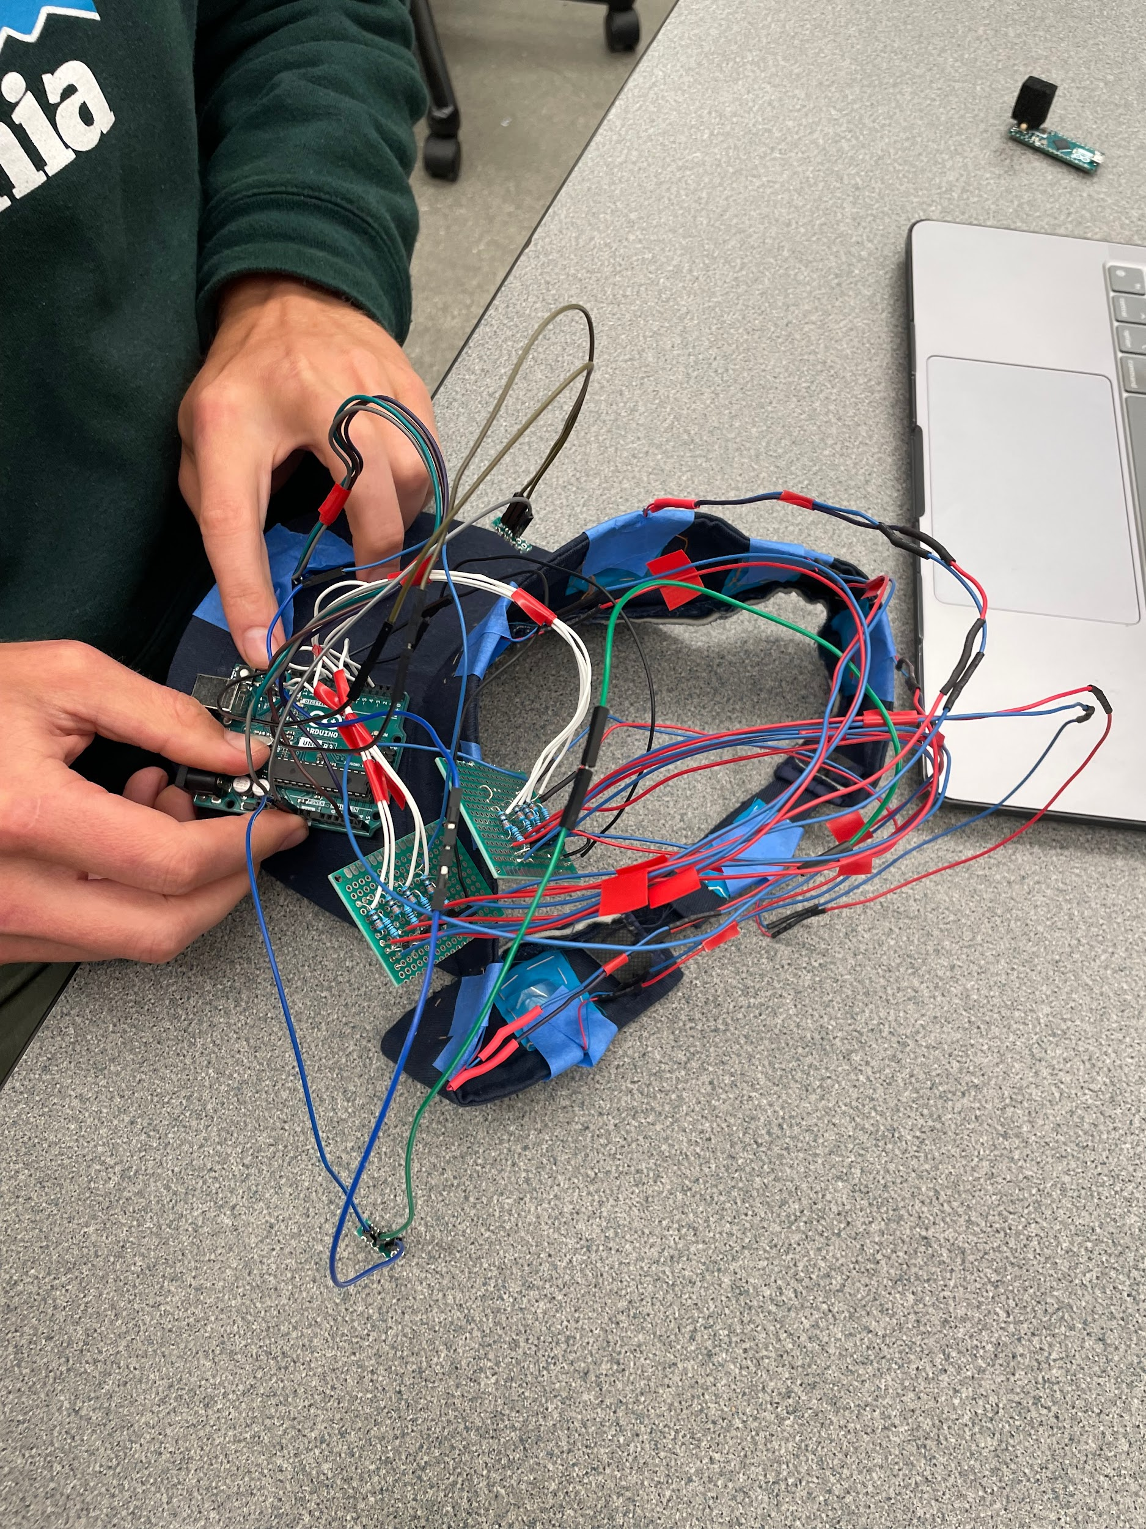
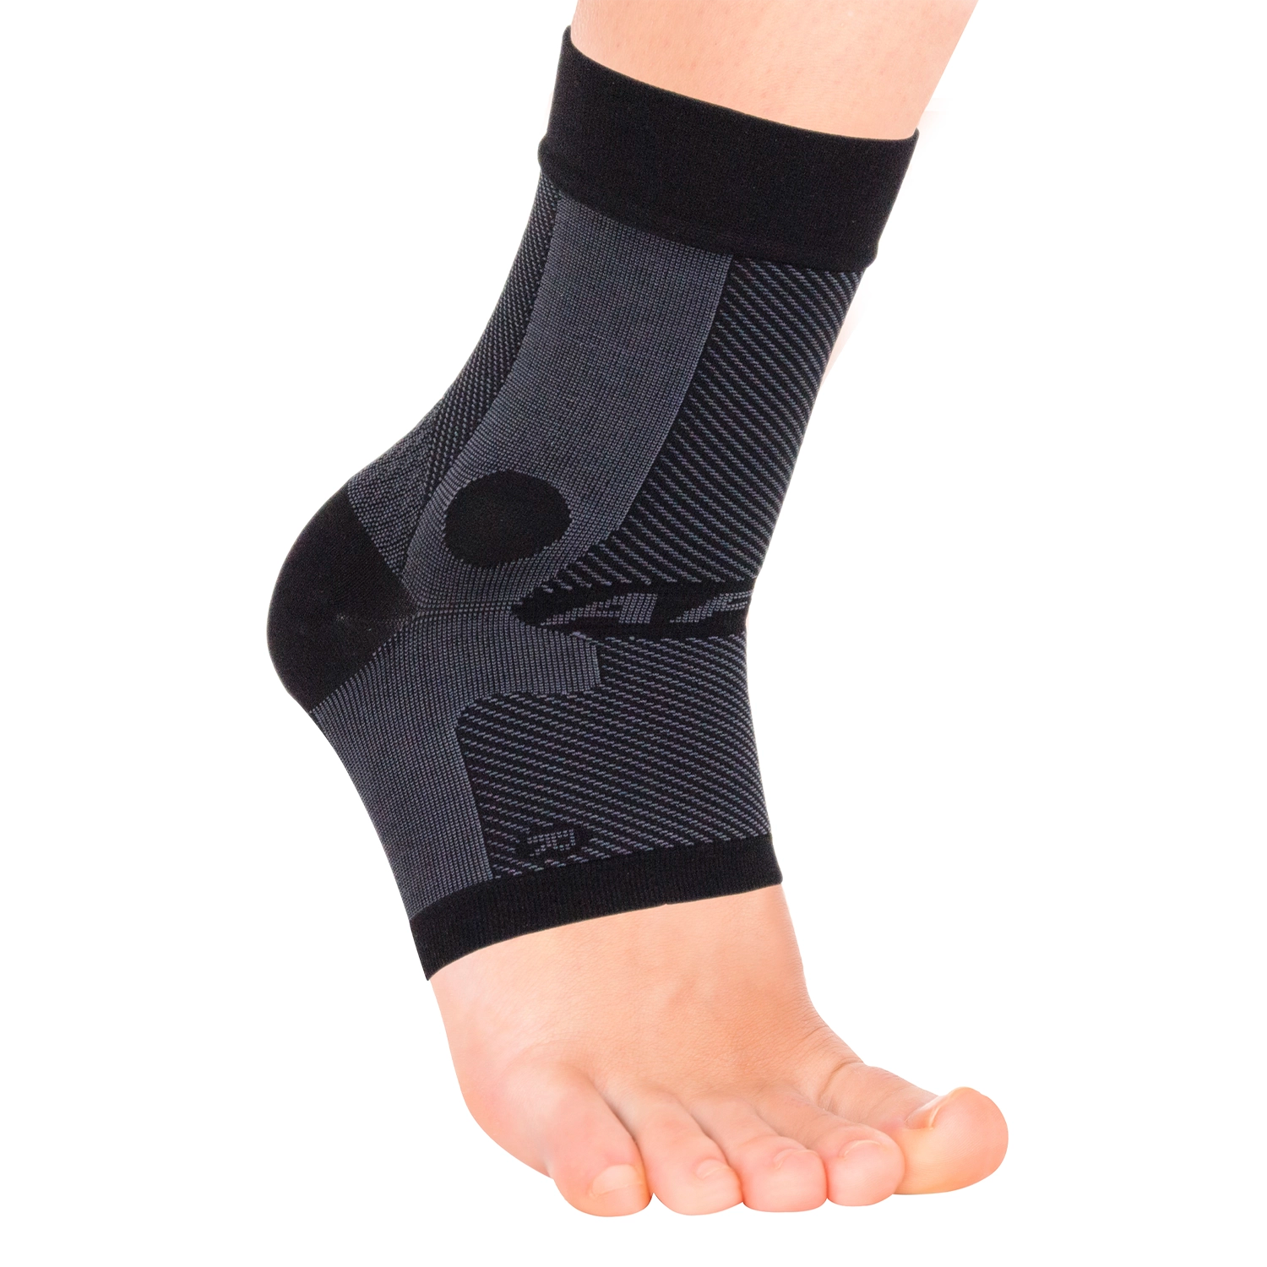
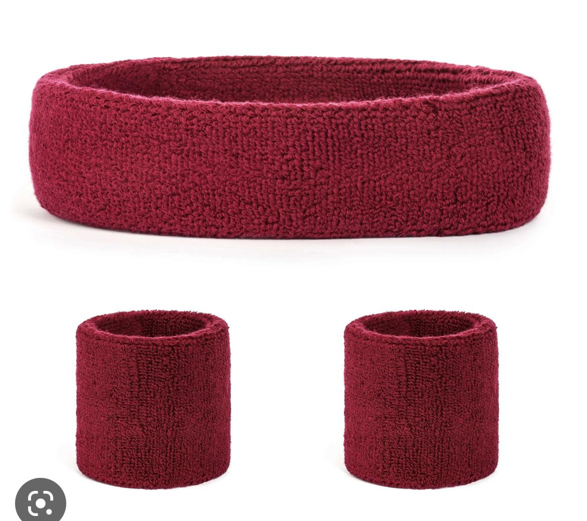
Wearable options
Notes:
majo

Slide 9
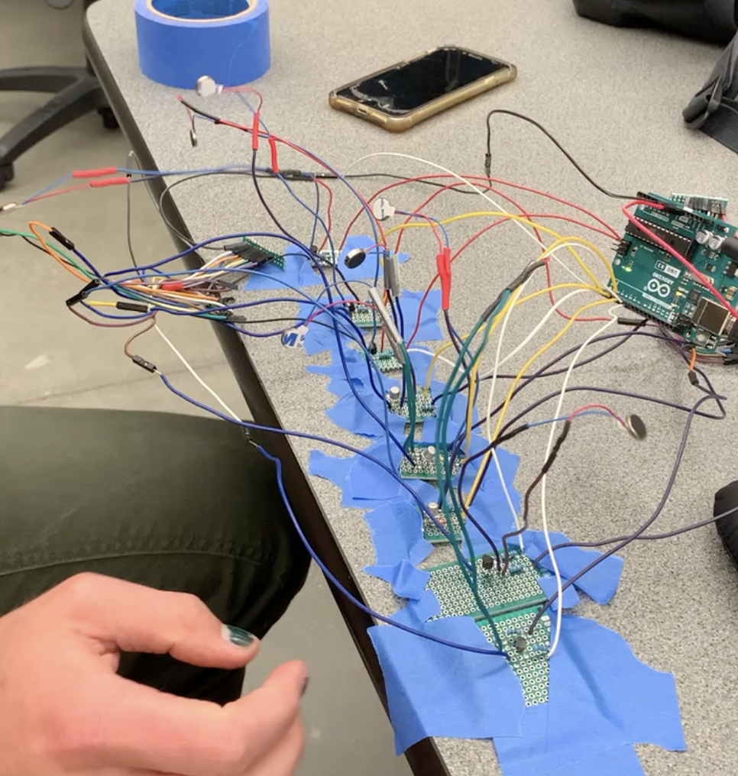
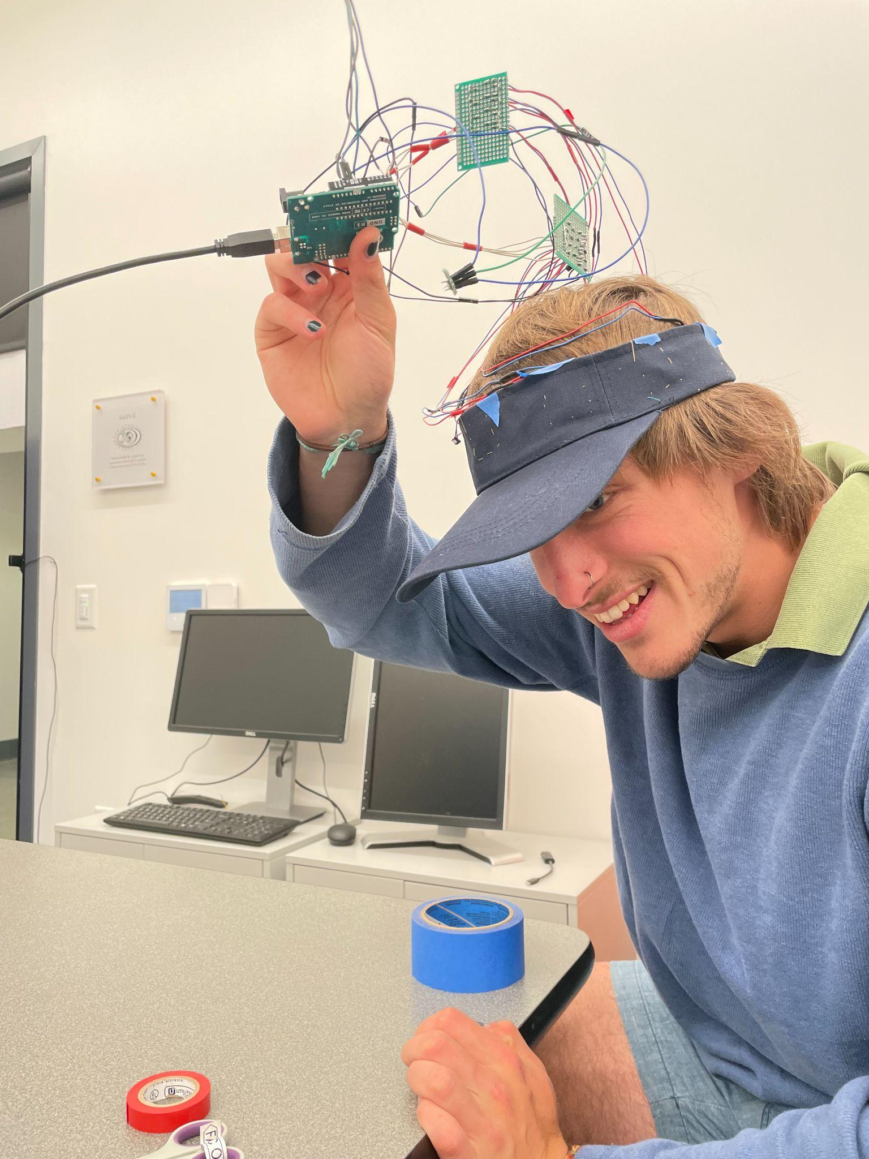
Putting in parallel and initial testing
Notes:
elijah

Slide 10
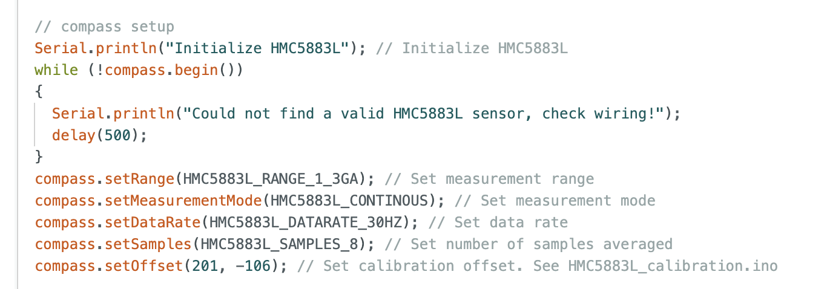
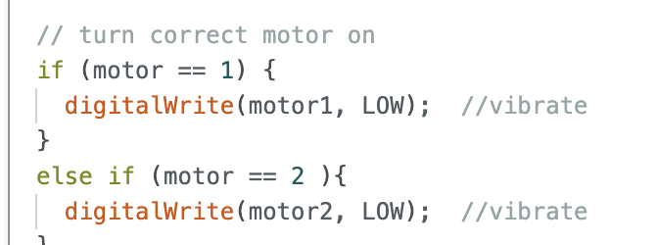
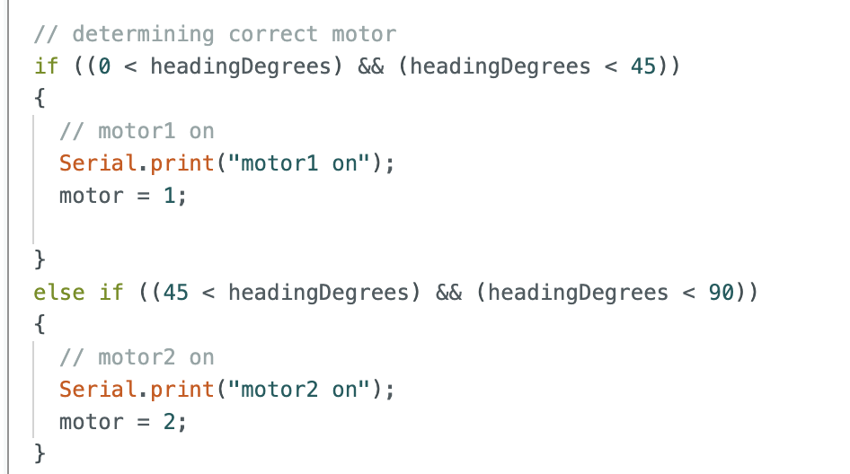
Summary of the code
Notes:
aly

Slide 11
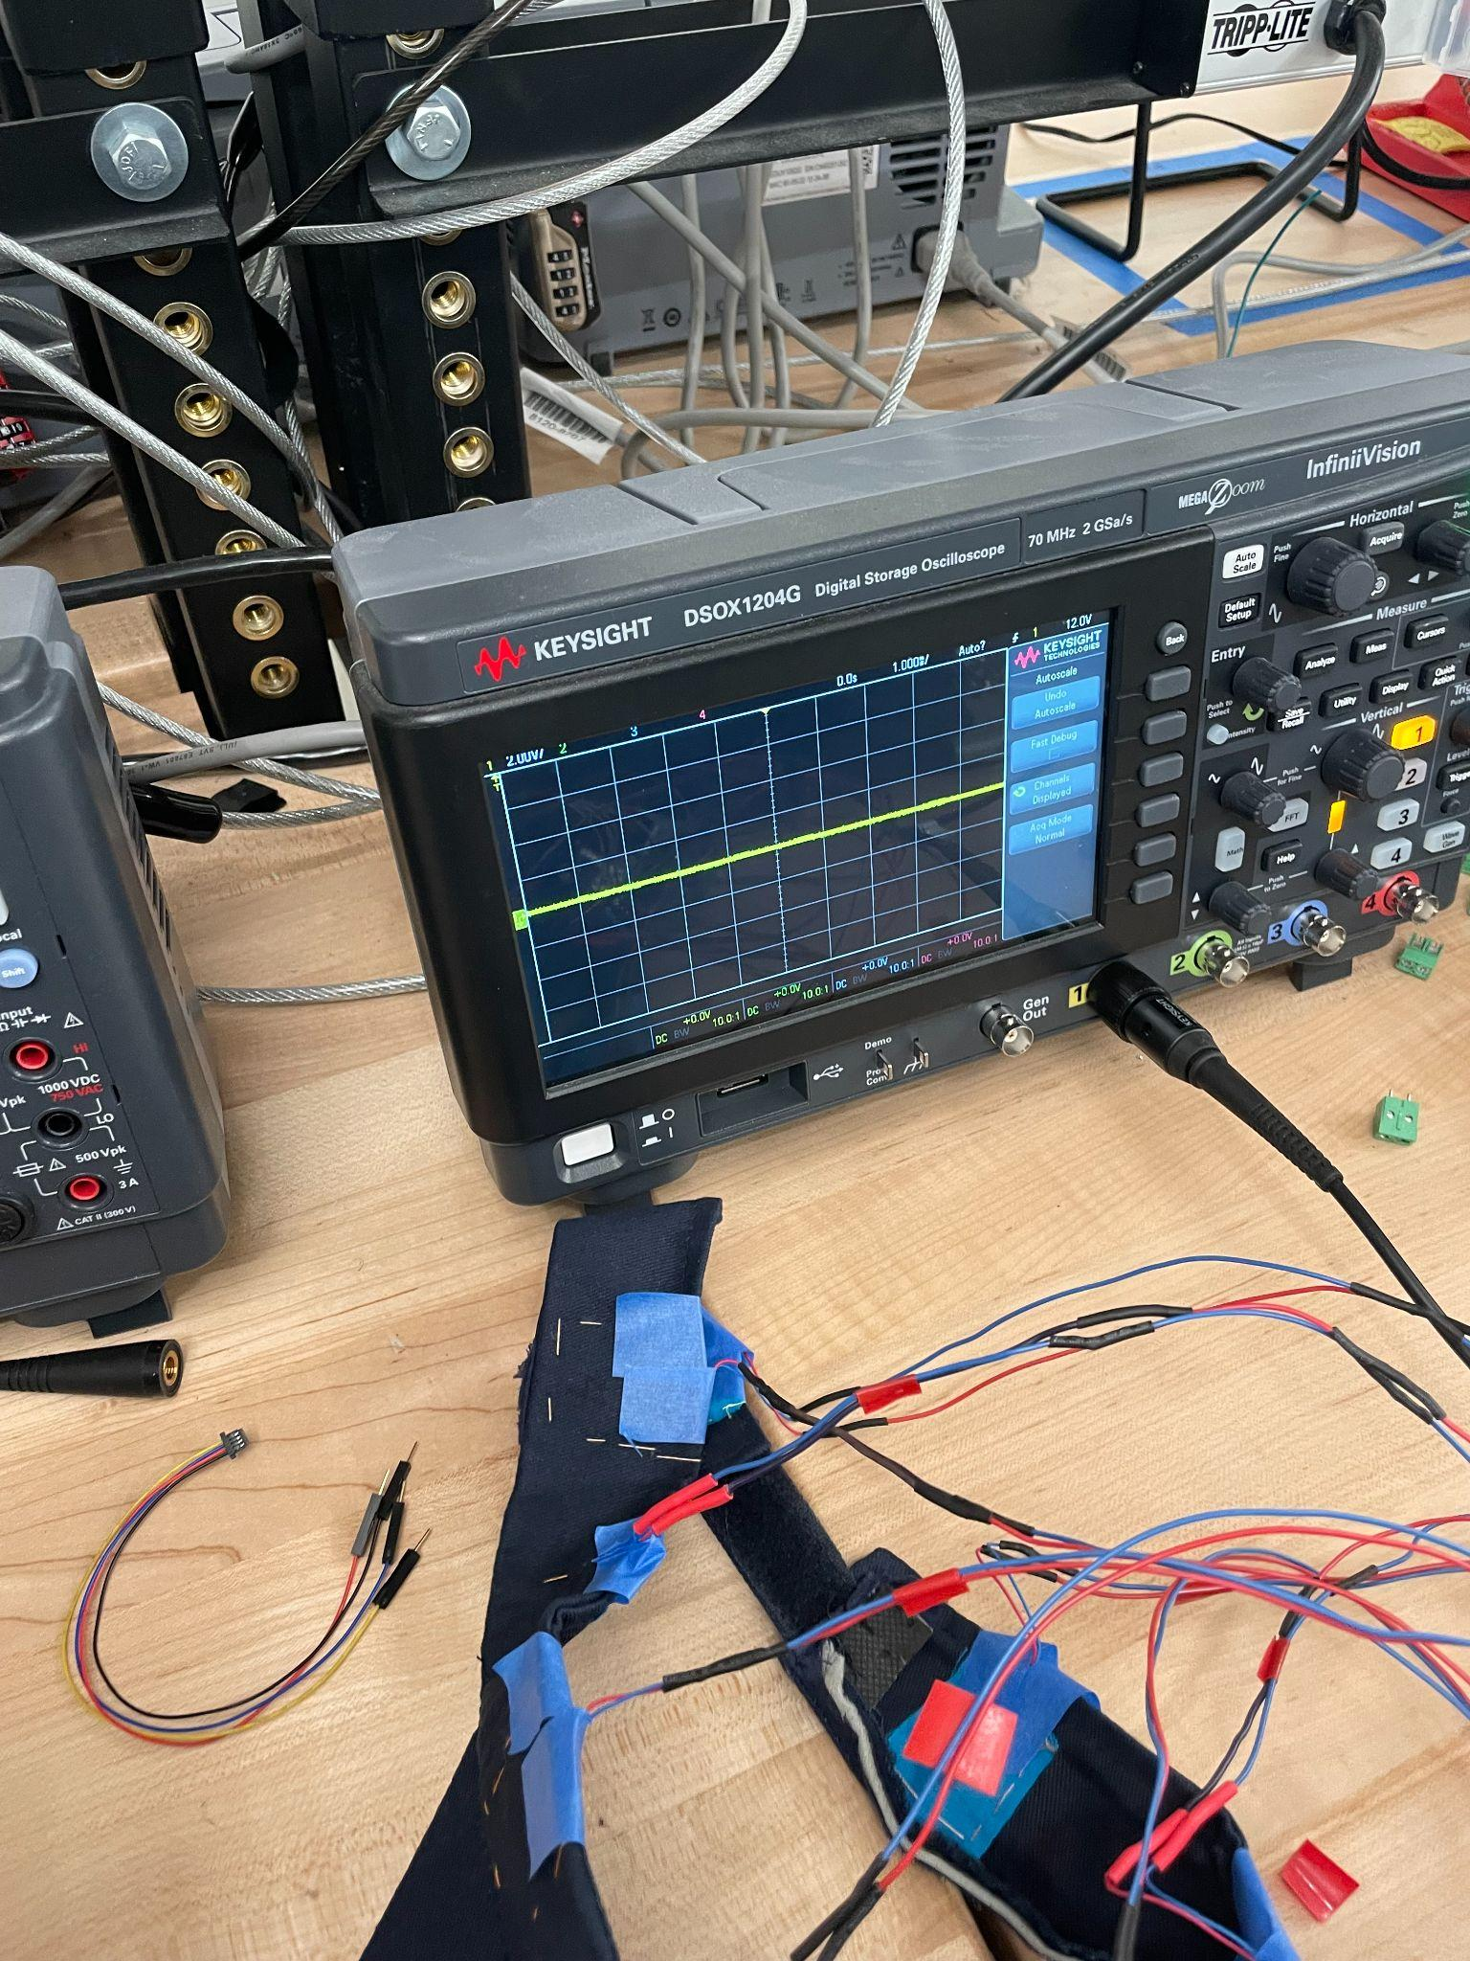
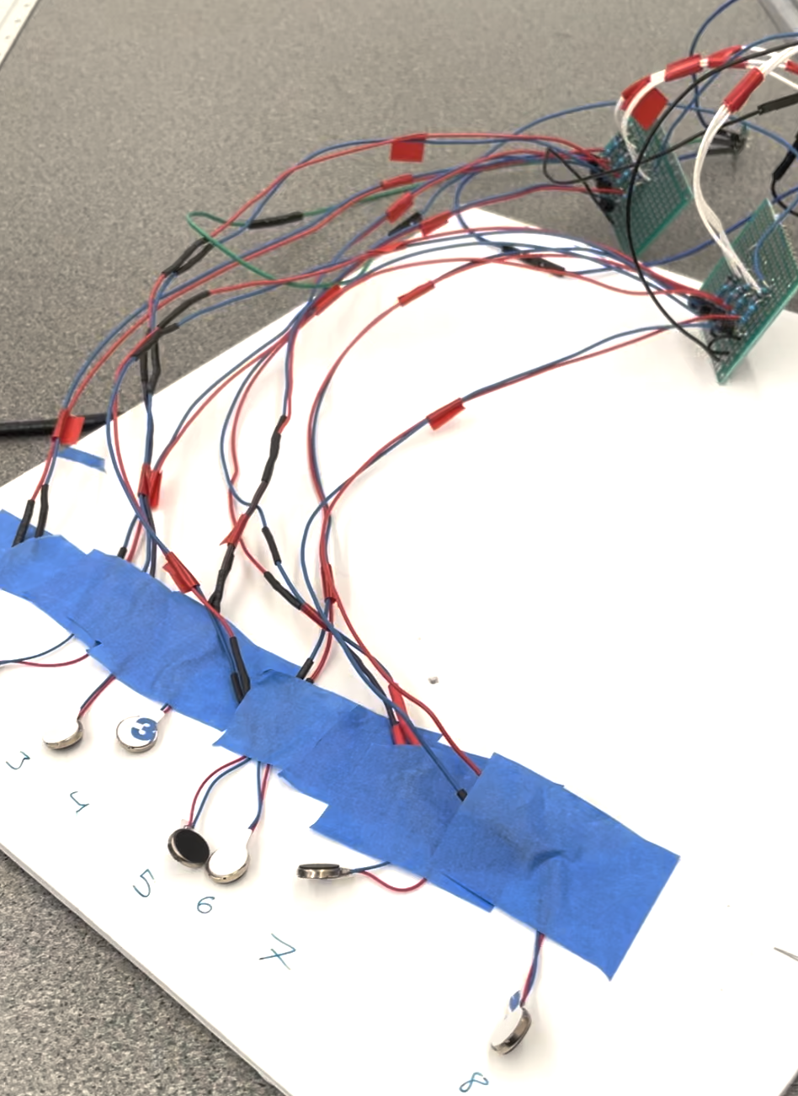
More testing…
Notes:
aly

Slide 12
Done!
Notes:
elijah

Slide 13
Possible improvements
01
02
Different Medium
Motors
What if we chose an option other than a hat?
Future iterations could include…
Having better and more continuous flow of motors
03
04
User experience
Streamlined
Creating a more stable, more comfortable device
Hiding the wires, potentially create our own PCB
Notes:
Taylor
In order to improve the device, we wanted to highlight what we could possibly better in future models.
Different Medium: Though the hat is functional, we hope to downsize the device in the future and make it more size inclusive for wearers
Motors: In future improvements we hope to have a more continuous flow of the motor buzz.
User Experience: Our original device is quite fragil and may be uncomfortable to a wearer, to better user experience we hope to improve its stability.
Streamlined: To streamline the device, we hope to design our own printed circuit board online and then print it, helping us divert from the Ardino and compressing the technology,

Slide 14
Acknowledgements and Credits
Thank you to Prof. Bang and Prof. Keeley for their guidance and support of this project. Additional thanks to Kavi Dey for his assistance in troubleshooting a multitude of issues. This project would not have been possible without them.
Thank you to The Hive for funding this project through the Course Activity Grant and to the Harvey Mudd Makerspace for letting us use their electronics space and components.
Brainy-Bits. (2020, October 28). Build an arduino RGB led ring compass. Brainy. Retrieved March 26, 2023, from https://www.brainy-bits.com/post/build-an-arduino-rgb-led-ring-compass
Machine learning infographics. Slidesgo. (n.d.). Retrieved March 26, 2023, from https://slidesgo.com/theme/machine-learning-infographics#search-machine+learning&position-1&results-4&rs=search
Sensebridge - making the invisible visible " North Paw. Sensebridge RSS. (n.d.). Retrieved March 26, 2023, from https://sensebridge.net/projects/northpaw/
techZeero. (2023, January 22). Vibration motor with Arduino - code, Circuit for Vibration Motor. techZeero. Retrieved March 26, 2023, from https://techzeero.com/arduino-tutorials/vibration-motor-with-arduino/
Notes:
We would like to acknowledge our professor support, Prof Keeley and Prof Bang. We also would like to thank Kavi Dey for helping troubleshoot our project.

Slide 15
Questions?
Thank you!

